Slide 1
Fruits Recognition Nouran Hassan
2022/00062
Fruits
Image processing presented to: Dr Alaa

Slide 2
Table of contents
01
02
03
04
Introduction
Dataset and Methodology
Problem Description and Objectives of the project
Dataset and the Steps of the project
Testing Results
Web application
Model training, Testing, Evaluation and accuracy
How I used the trained model to be used in a real life web app

Slide 3
01
Introduction
Problem Description and Overview

Slide 4
Introduction
Problem Description
Manual fruit classification is slow and error-prone, requiring an automated, efficient system for real-time recognition in agriculture and retail.
Objectives
To develop an efficient and accurate fruit recognition system using image processing and machine learning techniques, capable of classifying fruits from images in real-time through a web-based application.

Slide 5
02
Dataset and Methodology

Slide 6
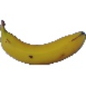
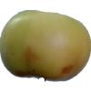
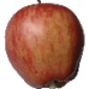
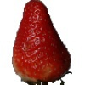
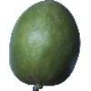
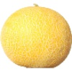
Dataset
The dataset used for this project is available on Kaggle and can be accessed through the following link: https://www.kaggle.com/datasets/moltean/fruits
Dataset Overview
The dataset comprises a collection of images featuring a variety of fruits, divided into three separate directories: training, validation, and testing. Each directory contains labeled images organized by class.

Slide 7
Methodology

Slide 8
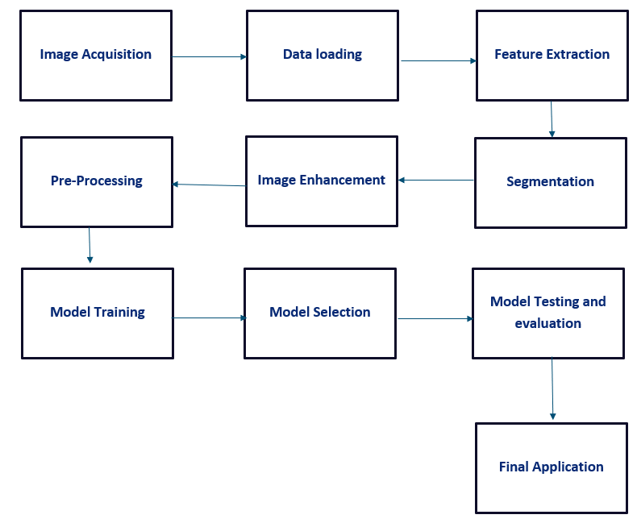
WorkFlow Diagram

Slide 9
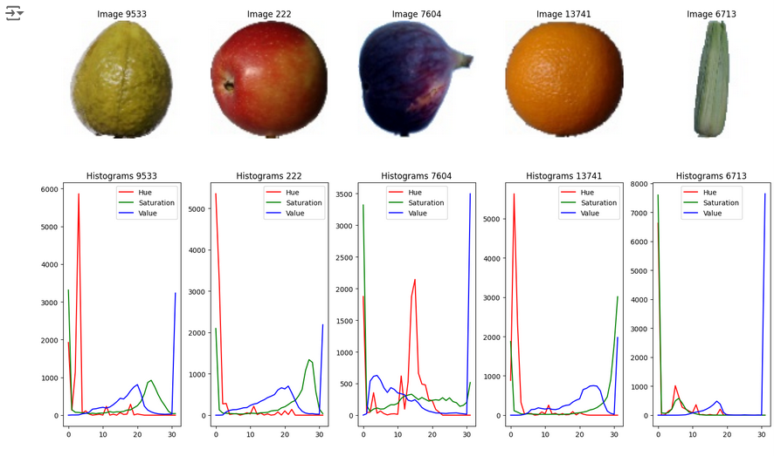
Implementation Steps
Step 1 - Image Acquisition
Dataset divided into Training and Testing directories.
Subfolders organized by fruit class.
Verified paths:
Training: /root/.cache/kagglehub/.../Training
Testing: /root/.cache/kagglehub/.../Test
Step 2 - Loading Data
Loaded images and labels from directories.
Images converted to NumPy arrays for processing.
Step 3 - Feature Extraction
Method: Color Histograms.
Images resized to 100x100 pixels, converted to HSV color space.
Computed histograms for Hue, Saturation, Value channels.
Features normalized and concatenated for uniform representation.

Slide 10
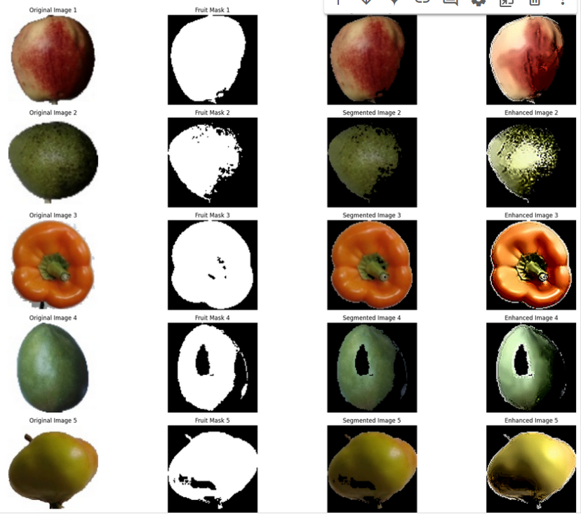
Implementation Steps
Step 4 - Image Segmentation & Enhancement
Segmentation:
Isolated fruit using color thresholds.
Converted to HSV and applied upper & lower bounds to mask the background.
Enhancement:
Techniques: Histogram Equalization, Noise Reduction, Denoising, Sharpening.
Improved brightness, contrast, and sharpness.
Step 5 - Image Preprocessing
Standardized extracted features using StandardScaler.
Updated preprocessing pipeline for both training and testing data.

Slide 11
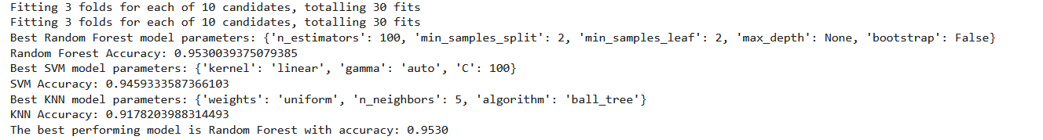
Implementation Steps
Step 6 - Model Training & Evaluation and Selection
Trained Models:
Support Vector Machines (SVMs), Random Forests, k-Nearest Neighbors (k-NN).
Hyperparameter Tuning:
Performed using Cross-Validation and Random Search.
Results:
Best Accuracy: 95.3% using Random Forest after tuning.
Evaluation Metrics: Accuracy, Precision, Recall, F1-Score.

Slide 12
03
Testing Results

Slide 13
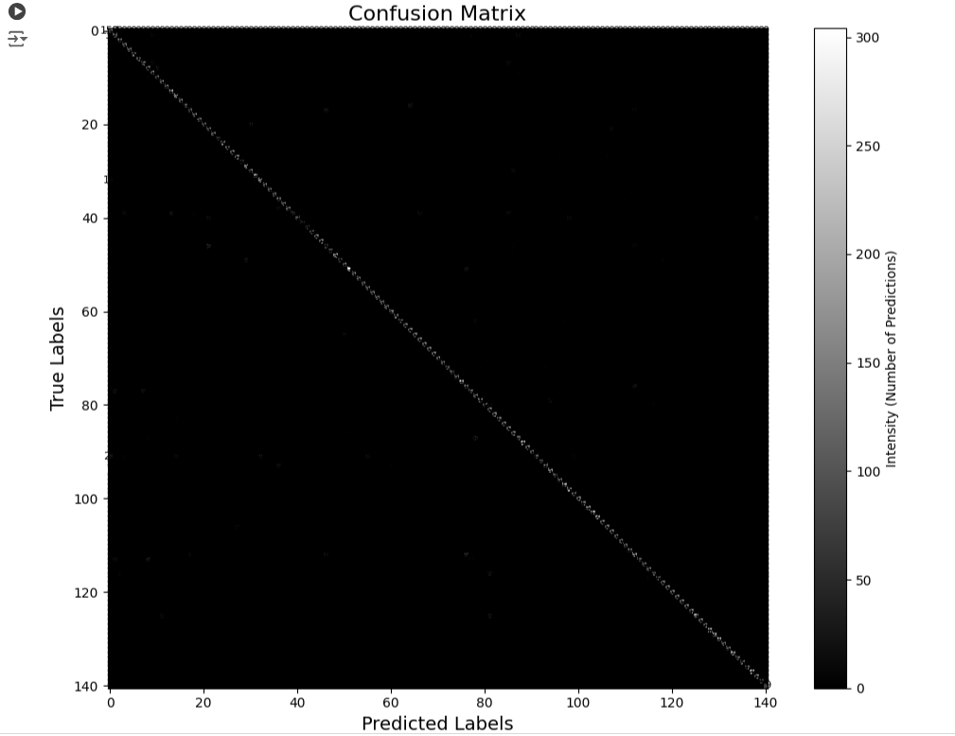
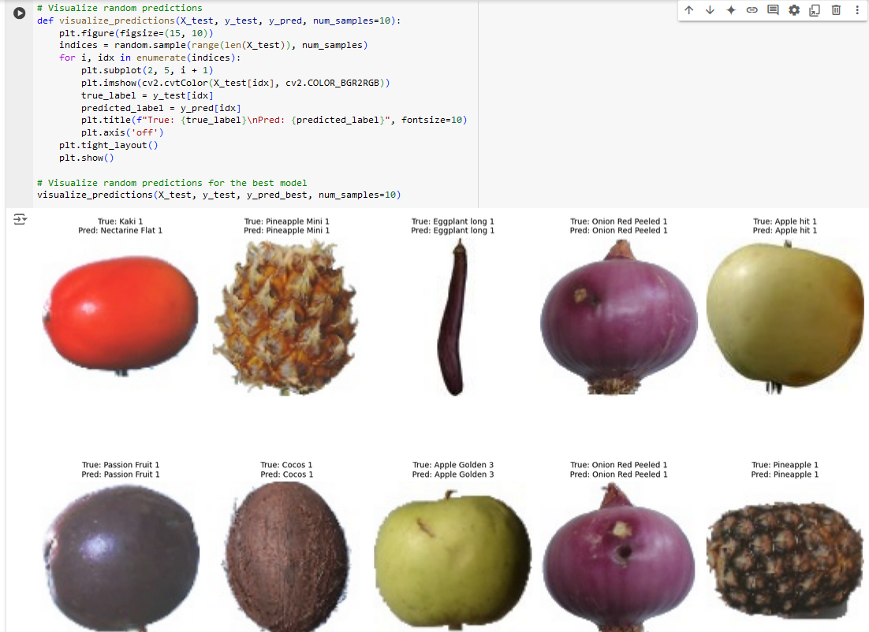
Testing Results
Confusion Matrix
Testing Function

Slide 14
04
Final Application
Flask-based web application.

Slide 15
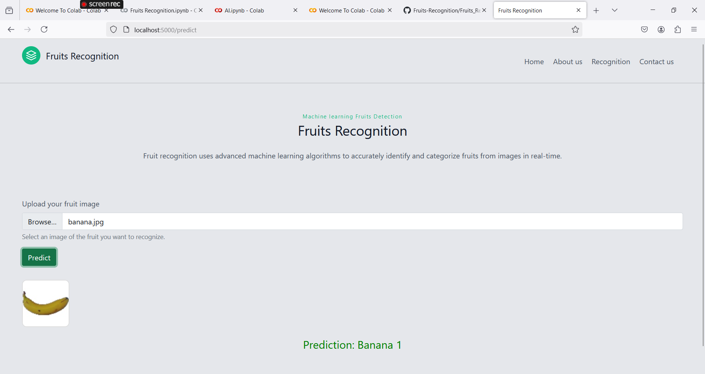
Final Application
Web Integration
Platform: Flask-based web application.
Features:
Users upload images for prediction.
Backend uses trained saved best model for real-time recognition.

Slide 16
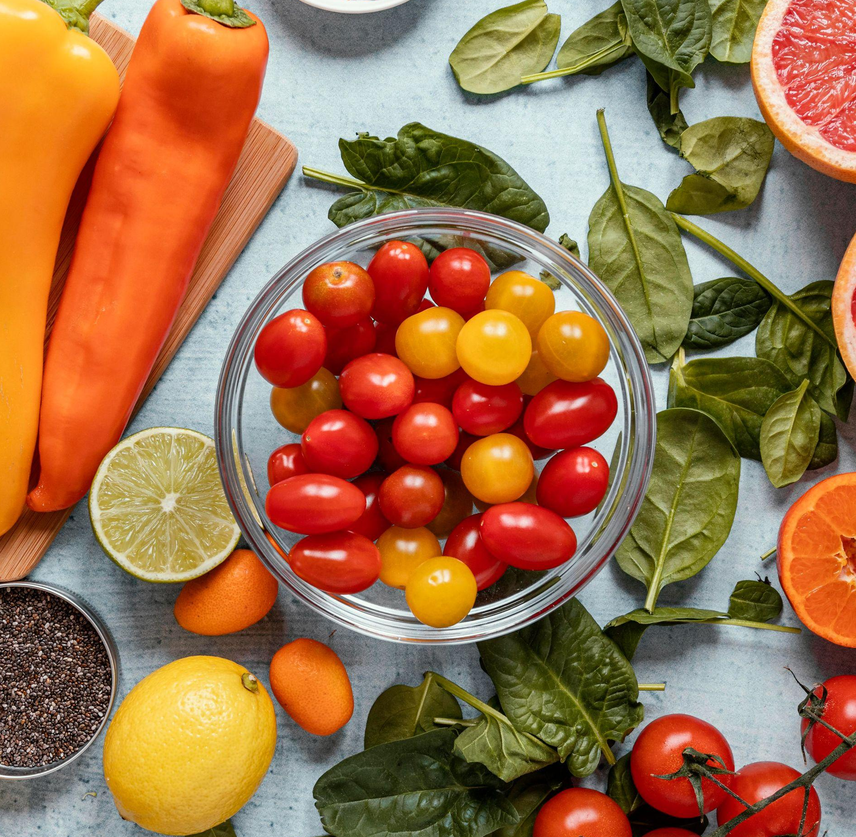
THANK YOU
Nouran Hassan Ahmed 2022/00062

